Slide 1
Diabetes Prediction with Machine Learning ML and Explainable AI (XAI)
Progress Report
Tayyeba Sadaq
BSc Computer Science

Slide 2
Introduction
Diabetes is a chronic illness characterised by consistent hyperglycaemia. It arises from the pancreas’ inability to produce sufficient insulin or the body’s ineffectiveness in utilising the produced insulin. In both cases, the condition’s long-term implications underline a critical need for timely diagnosis. Timely intervention as a result of early diagnosis means that the condition’s risks can often be significantly mitigated, and while there’s no real prevention to the disease, there are ways to adjust and manage one’s lifestyle in order to prevent complications and avoid a premature death.
Traditional diagnostic methods often rely on clinical tests such as fasting blood sugar levels, glucose tolerance tests and glycated haemoglobin (HbA1c) measurements to determine the presence and severity of diabetes. While effective, these are resource intensive methods and may not be as accessible to low-resource populations. Recent years have seen a development in Machine Learning (ML) and Artificial Intelligence (AI) as promising tools to enhance diabetes diagnosis and predictions, surpassing the traditional methods in both efficiency and scalability.

Slide 3
Objectives
Research Questions
To develop accurate ML models for diabetes prediction
To incorporate Explainable AI for interpretability
To help determine the most suitable ML model for diabetes prediction
To provide user friendly predictions for both patients and medical professionals
How effective are machine learning models in predicting diabetes
How can XAI improve the trust and understanding of predictions

Slide 4
Background and motivations
Global Impact:
According to the World Health Organisation, around 830 million people have diabetes, with over half not receiving treatment or a diagnosis.
Diabetes itself is a leading cause of several other medical issues such as: blindness, kidney failure and cardiovascular disease
Importance of Early Detection:
Early diagnosis reduce the complications diabetes causes on patient health as well as improve the quality of life with more management of lifestyle and other controllable factors
Machine Learning in Healthcare:
ML can analyse large datasets and establish patterns that correlate to certain diseases or health problems – helping predict diseases with high accuracy using patient data (unique diagnosis)
Explainable AI (XAI):
Healthcare decisions require transparency and trust. Alone, a ml diagnosis/prediction are very “black box” making it less likely to be adopted.
With explainability factors, a professional is more likely to adopt using ML to support diagnosis given they can clearly see how the model has come to a decision

Slide 5
Methodology overview
Data Source:
Data used – Pima Indians Diabetes Dataset (to find one other dataset to improve model predictions and make the data more universal)
Key features – pregnancies, glucose, insulin, BMI, skin thickness, blood pressure, diabetes pedigree function, age
Preprocessing:
Data cleaning (outliers – identifying quartiles)
Separating the independent features and target variables
Outcome proportionality – checking data is balanced
Model Development:
Logistic Regression
Random Forest
Gradient Boosting Model
Explainability:
LIME
SHAP (possibly)

Slide 6
Pre-processing

Slide 7
Key steps
Handling Missing Data
Removing/Managing outliers
Removing Duplicates
Standardising Data

Slide 8
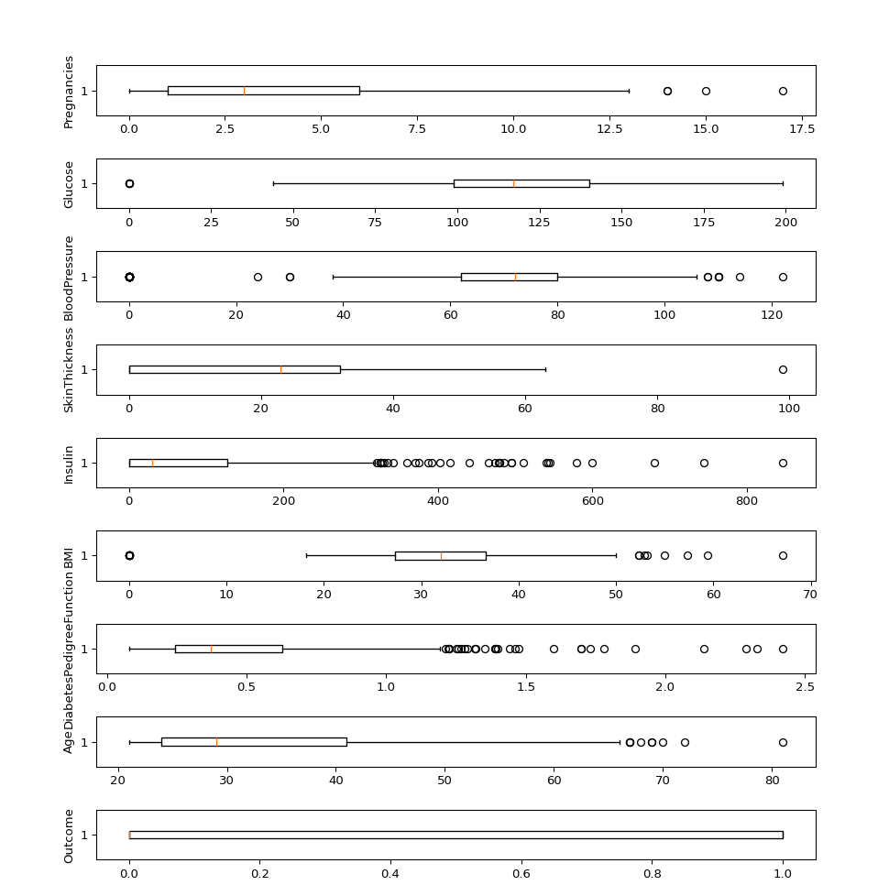
Box Plot – Outliers
Have Outliers
Insulin
BMI
Blood Pressure
Pregnancies

Slide 9
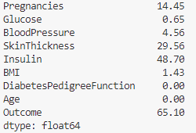
Missing Data
We can drop the null values from Glucose, Blood Pressure and BMI as it is a small potion that will still leave plenty of data for preprocessing and using to train and test the models
Outcome having 65% is not an issue since it just means that 65% of the diagnosis were 0 (non-diabetic)
Pregnancies, Insulin and Skin thickness will be handled instead of being removed.

Slide 10
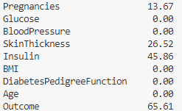
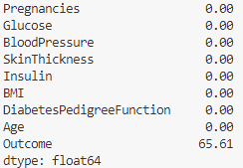
Handling Missing Data
Handled Glucose, Blood Pressure and BMI by dropping the null/0 instances since % is below 10.
Handled Pregnancies, Skin Thickness and Insulin with median since there were outliers for these features on boxplot so mean would skew data when giving diagnosis.

Slide 11
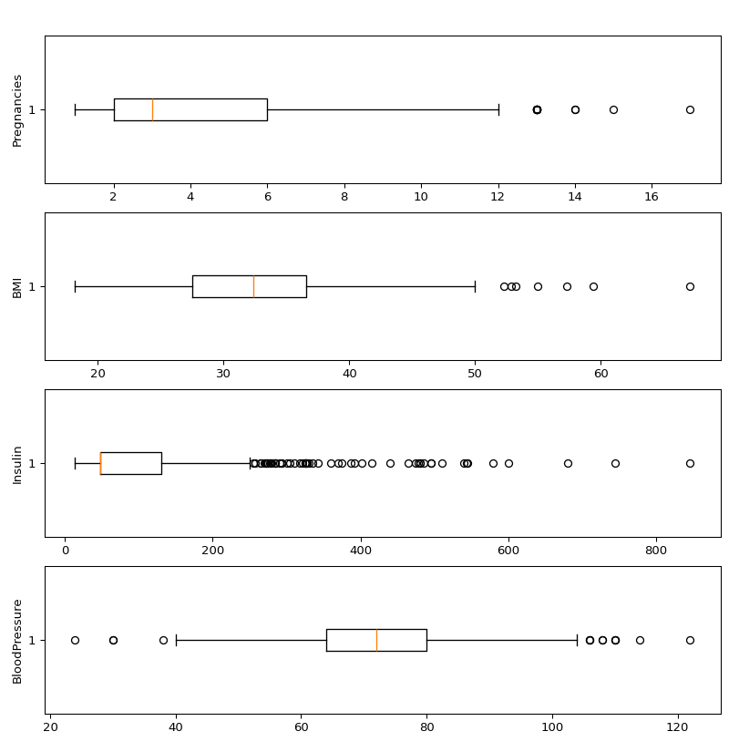
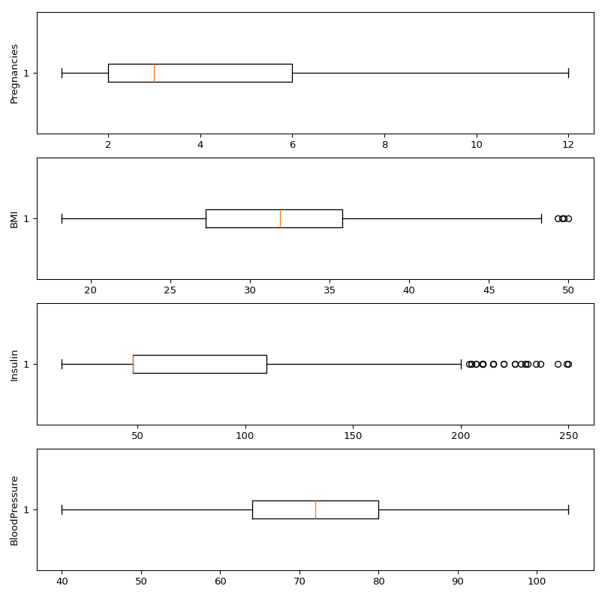
Handling the outliers
Pregnancies, Blood Pressure, BMI and Insulin were identified with outliers.
Using Interquartile range to handle the outliers as it avoids extreme sensitivity to outliers that can cause the mean to shift. Unlike z-score (which is still available in the code to test) that is more suitable for normally distributed data
Before
After

Slide 12
Data Standardisation
The data, when implemented for the models will have 2 versions:
Standardised
Non-Standardised
Why?
Logistic regression: needs standardisation due to coefficients that are affected by the scale of features. It ensures that all the features are on a comparable scale to improve the model’s performance
Random Forest: this is a tree-based model and therefore isn’t affected by scaling so there’s no advantage in doing so
Gradient Boosting: while also tree based, they’re build sequentially and therefore uses gradients to minimise the loss. When on different scales, the gradient calculations might not be as effective and so standardising the data makes sure the algorithm treats the features equally. Making it faster and more efficient.

Slide 13
Machine Learning Models

Slide 14
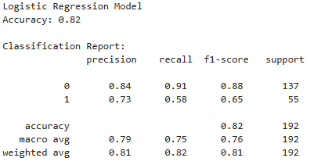
Logistic Regression
Description:
A linear model used for binary classification tasks
Diabetes = 1, No Diabetes = 0
Predicts the probability of an outcome using logistic function
Why is it suitable:
Simple and interpretable making it a good baseline
Effective for linearly separable data
Provides insight into feature importance (which features contributes most to diagnosis) through coefficients.

Slide 15
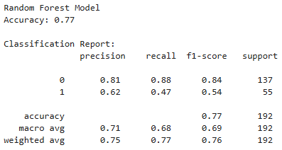
Random Forest
Description:
Ensemble learning methods that builds multiple decision trees and combines their output into the final prediction/diagnosis
Using bagging to reduce overfitting
Why is it suitable
Handles relationships and interactions between features (good for explainability implementation)
Good for handling outliers and missing data (given it works through multiple decision trees to make final decision)

Slide 16
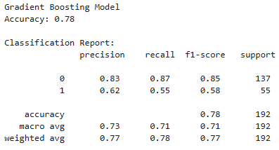
Gradient Boosting Model
Description:
Ensemble technique similar to random forest, but builds the trees sequentially
Building sequentially makes it correct errors from previous trees
Why is it suitable:
High predictive accuracy
Handles imbalanced datasets (common in healthcare)
Offers feature importance and partial dependence plots to help with interpretability

Slide 17
Explainable AI implementation

Slide 18
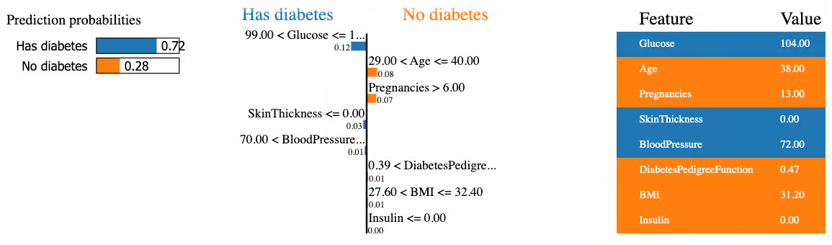
Local interpretable Model Agnostic Explanations
What is LIME:
A technique used to explain individual predictions of machine learning models
Works by approximating the model locally around a specific prediction
Why LIME:
Provides transparency and interpretability to the model diagnosis which is critical in healthcare fields given the sensitive nature of diagnosis health conditions
It can help both professionals and patients understand why a prediction has been made given the simplicity of the visuals it offers (when paired with explanation of what each part means)
Visual Example

Slide 19
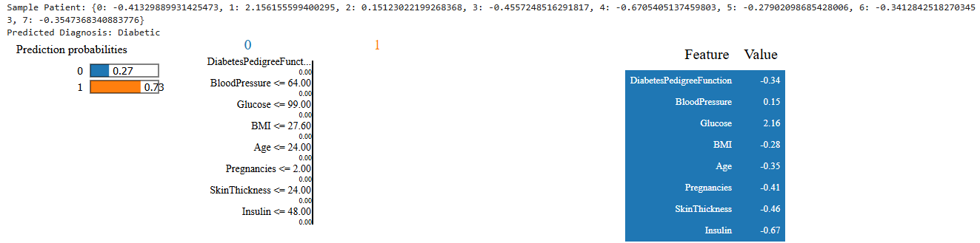
Logistic Regression and LIME
How it works:
Highlights each key feature for specific prediction
Generates linear explanation to show most influential features in prediction
Why is it suitable:
LR is inherently interpretable, but LIME adds more interpretability for specific cases

Slide 20
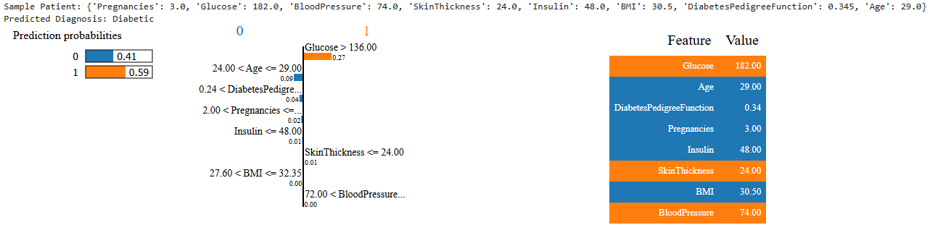
Random Forest and LIME
How it works:
LIME creates simplified explanations by approximating the complex group of decision trees
It identifies the features that contribute the most to the prediction
Why is it suitable
Due to the several decision trees, RF is less interpretable, but LIME bridges the gap by giving local, instance level explanations for the individual prediction

Slide 21
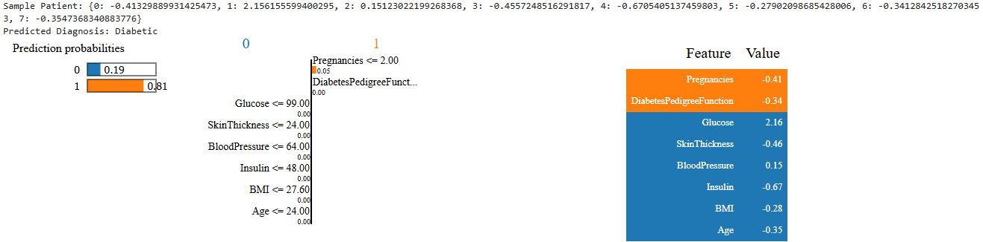
Gradient Boosting Model and LIME
How it works:
LIME explains the predictions by approximating the GBM behaviour locally
Highlights the contributing features to for the specific prediction
Why is it suitable:
GBM is complex with the sequential decision trees making but with individual predictions LIME can provide clarity like in the following case

Slide 22
Improving model

Slide 24
Frontend Development

Slide 25
Frontend Development Overview
Purpose of the Frontend:
User friendly interface
Visualisation of predictions
Real time interaction and diagnosis predictions
Key Features:
Input form
Prediction Output
LIME explanation
Model Selection
Responsive Design
Advice to manage condition (based on diagnosis)
Updated real world news on diabetes and global prevalence map

Slide 26
Technologies
Frontend Framework
React Native Expo (mobile and web development)
Visualisation Libraries
Chart.js and/or Plotly for displaying LIME explanation and homepage visualisation
Backend Integration
Flask Python Application to connect frontend to ML models and XAI components
Deployment

Slide 27
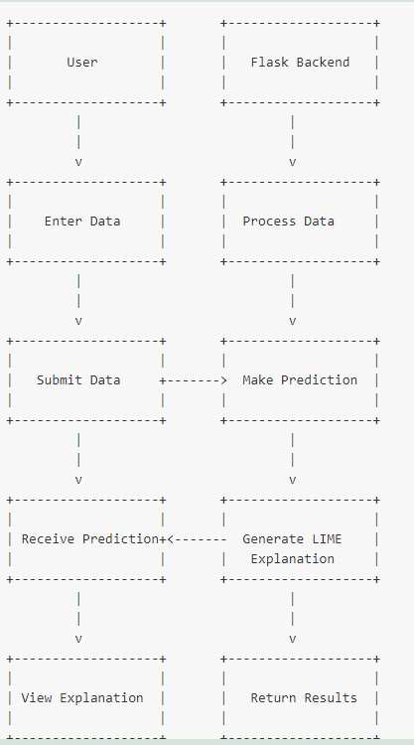
Use Case Diagram

Slide 28
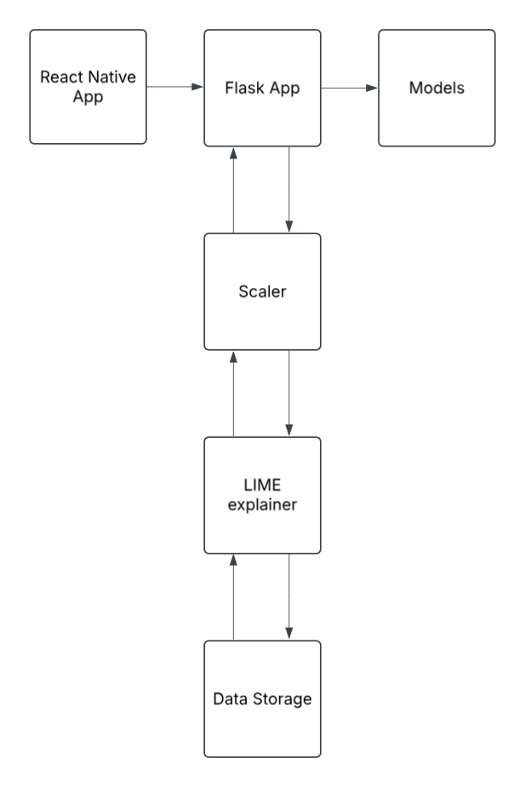
Architecture Diagram
The client sends a POST request with input data to the Flask app
The Flask app processes the input data, scaling it for LR and GBM models to make predictions
Flask app then uses LIME explainer to generate the explanation for the predictions
The predictions and explanations are then returned to the client and displayed accordingly

Slide 29
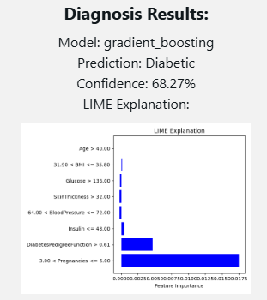
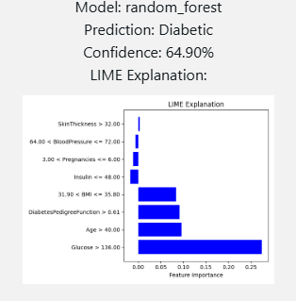
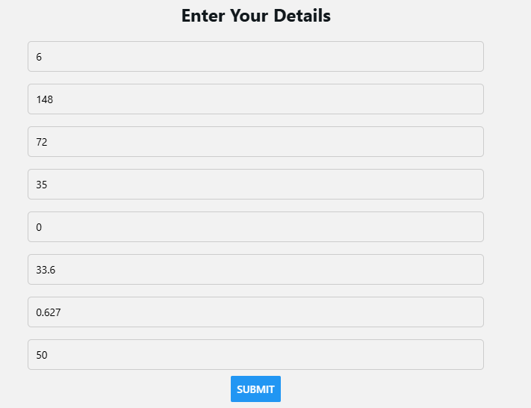
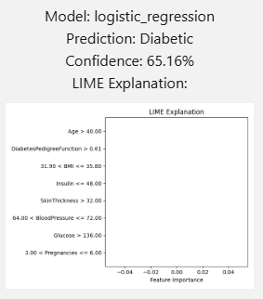
UI and Visualisation

Slide 30
Demo

Slide 31
Video Demo

Slide 32
Challenges and future improvements

Slide 33
Challenges

Slide 34
Future Improvements

Slide 35
END

